Slide 1

AGE
ACCESS
AND ABILITY
Analyzing the BCE 2023
Quantitative Spatial Sciences Lab
University of Bristol

Slide 2
Alistair Anderson Isabelle Bi
Joseph Day Nicholas Dorward
Sean Fox Lenka Hašová
David Manley Emmanouil Tranos
Levi John Wolf
Who is Quantitative Spatial Sciences Lab?

Slide 3
Alistair Anderson Isabelle Bi
Joseph Day Nicholas Dorward
Sean Fox Lenka Hasova
David Manley Emmanouil Tranos
Levi John Wolf
Who is Quantitative Spatial Sciences Lab?

Slide 4
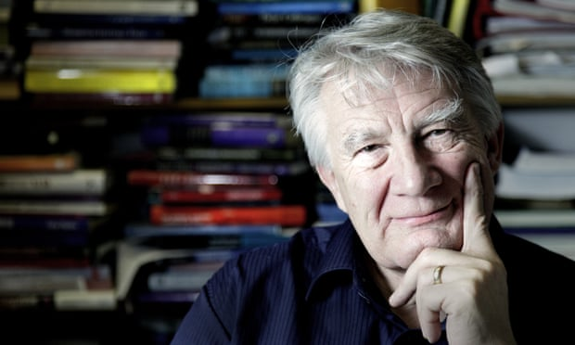
Alistair Anderson Isabelle Bi
Joseph Day Nicholas Dorward
Sean Fox Lenka Hasova
David Manley Emmanouil Tranos
Levi John Wolf
Who is Quantitative Spatial Sciences Lab?

Slide 5
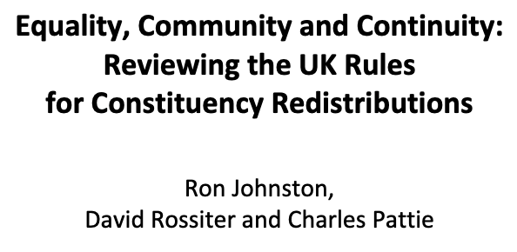
Alistair Anderson Isabelle Bi
Joseph Day Nicholas Dorward
Sean Fox Lenka Hasova
David Manley Emmanouil Tranos
Levi John Wolf
Who is Quantitative Spatial Sciences Lab?

Slide 6
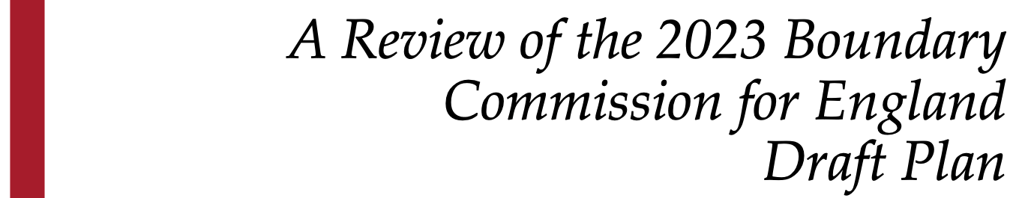
Alistair Anderson Isabelle Bi
Joseph Day Nicholas Dorward
Sean Fox Lenka Hasova
David Manley Emmanouil Tranos
Levi John Wolf
QuSS Report on BCE 2023

Slide 7
QuSS Report on BCE 2023

Slide 8
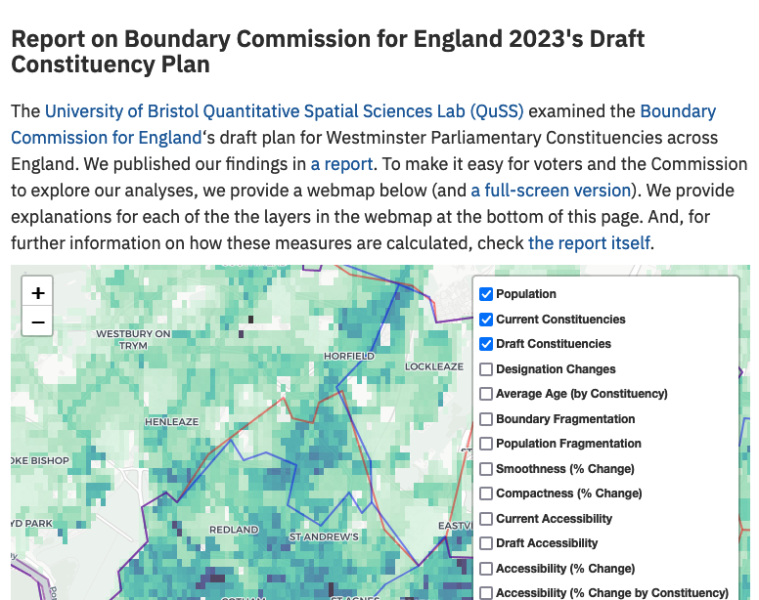
QuSS Report on BCE 2023

Slide 9
CLICK TO EDIT THE TITLE TEXT
DESIGNATION AND DENSITY
POPULATION
PLACE & COMMUNITY

Slide 10
CLICK TO EDIT THE TITLE TEXT
Constituencies become oddly-shaped and less accessible
POPULATION
PLACE & COMMUNITY
Young voters are severely disempowered
“Borough”/“County” is inconsistently applied

Slide 11
CLICK TO EDIT THE TITLE TEXT
Constituencies become oddly-shaped and less accessible
POPULATION
PLACE & COMMUNITY
Young voters are severely disempowered
“Borough”/“County” is inconsistently applied

Slide 12
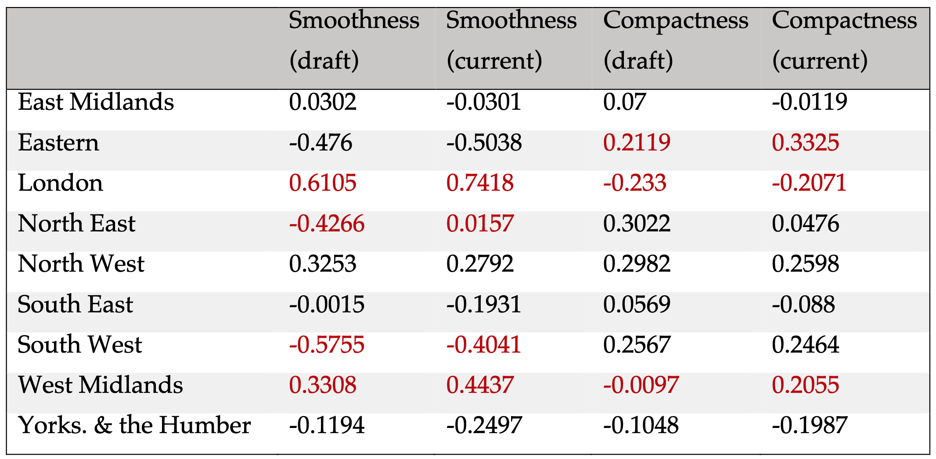
Constituencies become oddly-shaped and less accessible
Table 1 (p. 12)

Slide 13
London const’s. become ”wiggly” and elongated
Constituencies become oddly-shaped and less accessible
Table 1 (p. 12)

Slide 14
North West const’s.
become less so
Constituencies become oddly-shaped and less accessible
Table 1 (p. 12)

Slide 15
Here, const’s become more “wiggly” while staying compact
Constituencies become oddly-shaped and less accessible
Table 1 (p. 12)

Slide 16
WHO CARES?
Here, const’s become more “wiggly” while staying compact
Constituencies become oddly-shaped and less accessible
Table 1 (p. 12)

Slide 17
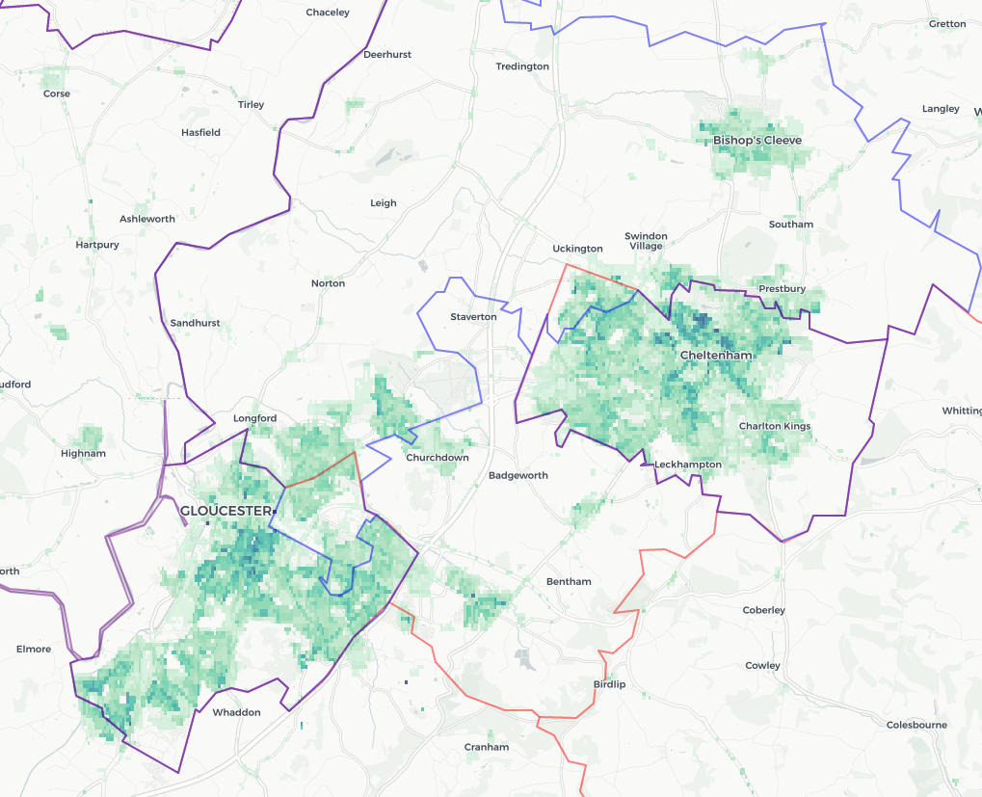
CURRENT
DRAFT
POP
Here, const’s become more “wiggly” while staying compact
Constituencies become oddly-shaped and less accessible.
Table 1 (p. 12)

Slide 18


CURRENT
DRAFT
POP
Here, const’s become more “wiggly” while staying compact
Constituencies become oddly-shaped and less accessible.
Table 1 (p. 12)

Slide 19
CURRENT
DRAFT
POP
Here, const’s become more “wiggly” while staying compact
Constituencies become oddly-shaped and less accessible.
Const’s. becoming less smooth while staying compact will, by & large, have these “slices.”
When this involves changing populations, it can indicate
“fracturing” where voter
preferences are diluted by
splitting communities.
Table 1 (p. 12)

Slide 20
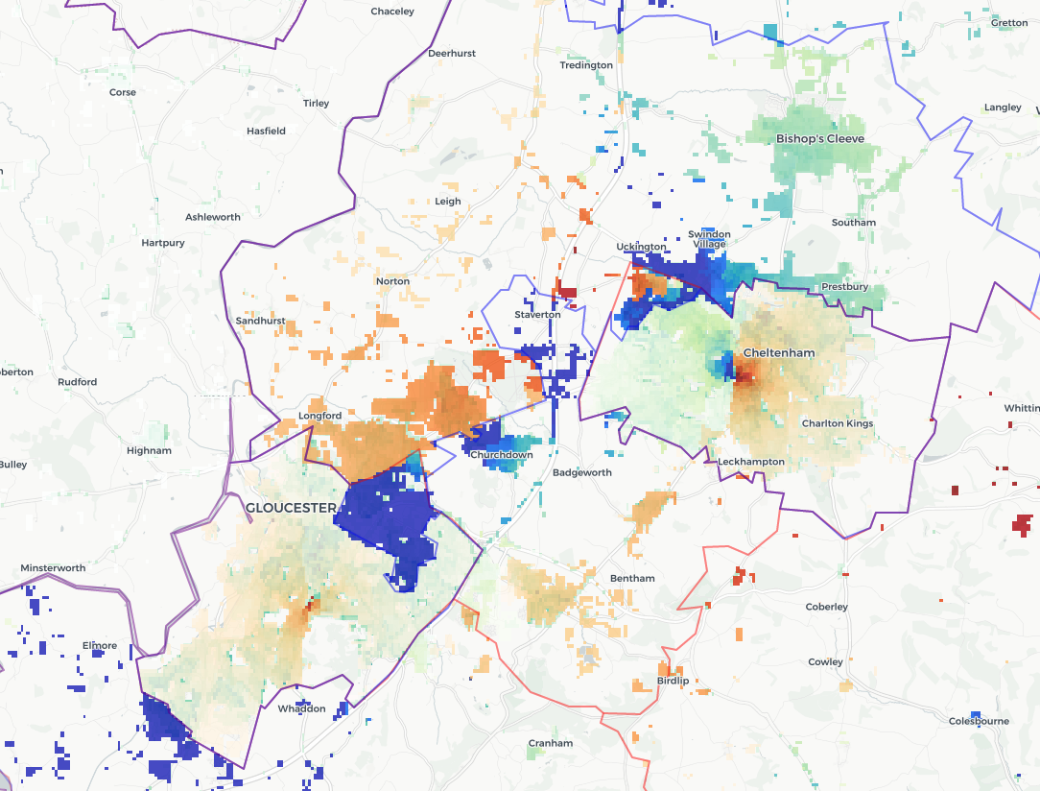
BETTER
DRAFT
WORSE
Here, const’s become more “wiggly” while staying compact
Constituencies become oddly-shaped and less accessible.
Table 1 (p. 12)
When this involves changing populations, it can indicate
“fracturing” where voter
preferences are diluted by
splitting communities.

Slide 21
BETTER
DRAFT
WORSE
Here, const’s become more “wiggly” while staying compact
Constituencies become oddly-shaped and less accessible.
Table 1 (p. 12)
When this involves changing populations, it can indicate
“fracturing” where voter
preferences are diluted by
splitting communities.

Slide 22
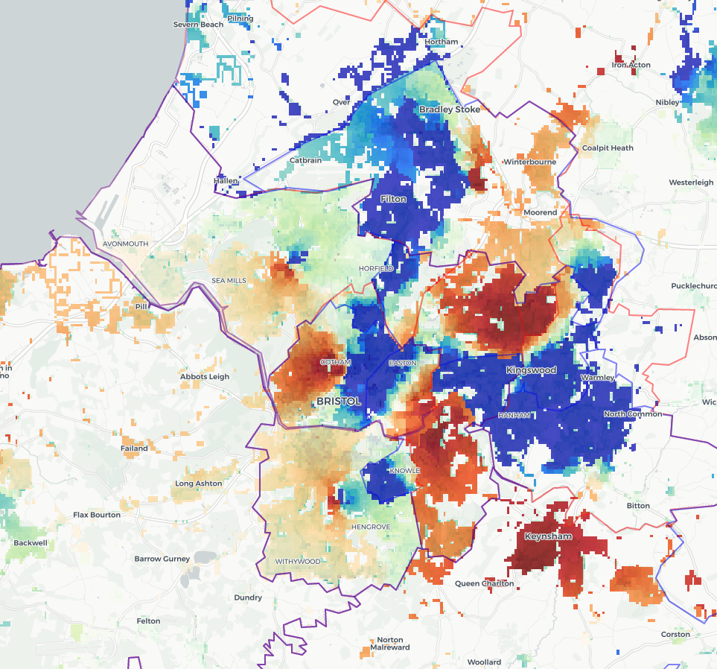
Bristol South, Bristol East, and Bristol North have much worse const. accessibility due to shifting boundaries that ”pack” more deprived communities into Bristol North/North East.
(p. 3)
Here, const’s become more “wiggly” while staying compact
Table 1 (p. 12)

Slide 23
Constituencies become oddly-shaped and less accessible
Table 1 (p. 12)

Slide 24
Constituencies become oddly-shaped and less accessible
Table 1 (p. 12)

Slide 25
CLICK TO EDIT THE TITLE TEXT
Constituencies become oddly-shaped and less accessible
POPULATION
PLACE & COMMUNITY
Young voters are severely disempowered
“Borough”/“County” is inconsistently applied

Slide 26
CLICK TO EDIT THE TITLE TEXT
Constituencies become oddly-shaped and less accessible
POPULATION
PLACE & COMMUNITY
Young voters are severely disempowered
“Borough”/“County” is inconsistently applied

Slide 27
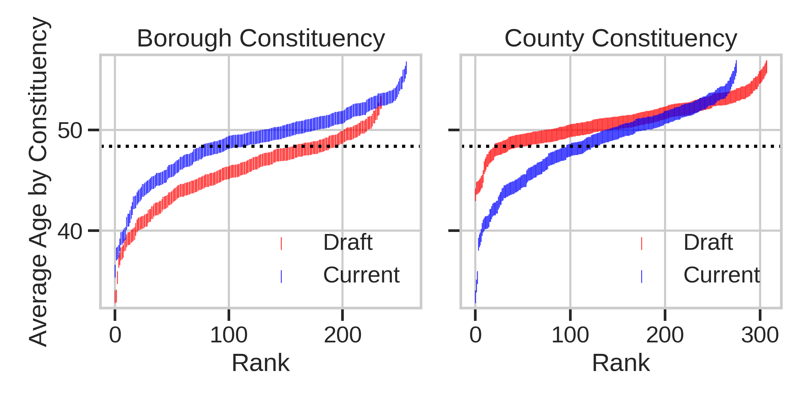

Slide 28
YOUNGER OLDER

Slide 29
YOUNGER OLDER
Young voters are now intensely concentrated in Borough Const’s.

Slide 30
CLICK TO EDIT THE TITLE TEXT
Constituencies become oddly-shaped and less accessible
POPULATION
PLACE & COMMUNITY
Young voters are severely disempowered
“Borough”/“County” is inconsistently applied

Slide 31
CLICK TO EDIT THE TITLE TEXT
Constituencies become oddly-shaped and less accessible
DESIGNATIONAND DENSITY
Young voters are severely disempowered
“Borough”/“County” is inconsistently applied

Slide 32

Where const’s. contain more than a small rural element, they should normally be designated as county const’s. In other cases, they should be designated as borough const’s. The designation also determines the limit on the amount that a candidate is allowed to spend […] the limit is slightly lower in borough, to reflect the lower costs of running a campaign in a more geographically compact urbanized area.
“Borough”/“County” is inconsistently applied

Slide 33
Where const’s. contain more than a small rural element, they should normally be designated as county const’s. In other cases, they should be designated as borough const’s. The designation also determines the limit on the amount that a candidate is allowed to spend […] the limit is slightly lower in borough, to reflect the lower costs of running a campaign in a more geographically compact urbanized area.
“Borough”/“County” is inconsistently applied

Slide 34
Where const’s. contain more than a small rural element, they should normally be designated as county const’s. In other cases, they should be designated as borough const’s. The designation also determines the limit on the amount that a candidate is allowed to spend […] the limit is slightly lower in borough, to reflect the lower costs of running a campaign in a more geographically compact urbanized area.
“When spending limits are increased [i.e. when boroughs become counties], campaigns become more expensive […]; the pool of candidates shrinks, and elections become less competitive; and the financial and electoral incumbency advantages
are amplified.” (Fouirnaies, 2021)

Slide 35
Where const’s. contain more than a small rural element, they should normally be designated as county const’s. In other cases, they should be designated as borough const’s. The designation also determines the limit on the amount that a candidate is allowed to spend […] the limit is slightly lower in borough, to reflect the lower costs of running a campaign in a more geographically compact urbanized area.
Counties will see fewer candidates from fewer parties run elections that favor the sitting MP.
Boroughs will see more competitive elections among more candidates that change more often.

Slide 36
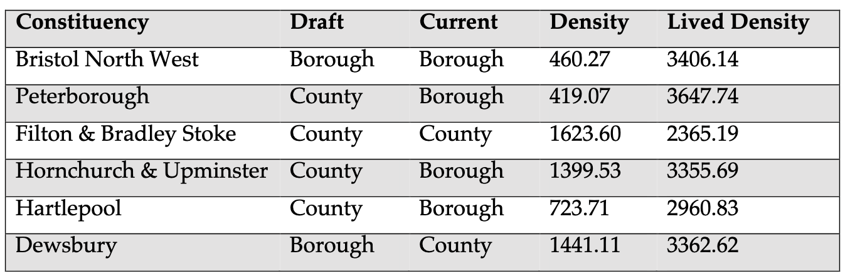
“Borough”/“County” is inconsistently applied

Slide 37
H&U (county-to-borough) is less “urbanized” than Dewsbury (borough-to-county)…

Slide 38
H&U (county-to-borough) is less “urbanized” than Dewsbury (borough-to-county)… both are more “urban” than Hartlepool, which becomes
a borough w/ little boundary change!

Slide 39
CLICK TO EDIT THE TITLE TEXT
DESIGNATION AND DENSITY
POPULATION
PLACE & COMMUNITY

Slide 40
CLICK TO EDIT THE TITLE TEXT
The “double bind”: young voters are strongly packed into urban districts. These also have lower spending caps, more competitive elections, and stronger third-party competition.
Constituencies in this plan are more oddly-shaped, and less reflective of the current population distribution, especially at the city/country edge.

Slide 41
WHAT OF IT?
CLICK TO EDIT THE TITLE TEXT
The “double bind”: young voters are strongly packed into urban districts. These also have lower spending caps, more competitive elections, and stronger third-party competition.
Constituencies in this plan are more oddly-shaped, and less reflective of the current population distribution, especially at the city/country edge.

Slide 42
Constituencies are something that we make, and could just as easily make differently

Slide 43
Constituencies are something that we make, and could just as easily make differently
[B]y replacing a situation in which opposing interests could debate their proposals and counter-proposals to one in which ‘views were heard’ but not challenged … evidence presented by the interested parties was not tested in a public forum – which may set precedents for other situations where public consultation is considered necessary but where it is in the proposers’ interests
to limit its scope and potential impact.
(Johnston et al. 2013)

Slide 44
Constituencies are something that we make, and could just as easily make differently
[B]y replacing a situation in which opposing interests could debate their proposals and counter-proposals to one in which ‘views were heard’ but not challenged … evidence presented by the interested parties was not tested in a public forum – which may set precedents for other situations where public consultation is considered necessary but where it is in the proposers’ interests
to limit its scope and potential impact.
(Johnston et al. 2013)

Slide 45
WHO
GETS HEARD?
Constituencies are something that we make, and could just as easily make differently
[B]y replacing a situation in which opposing interests could debate their proposals and counter-proposals to one in which ‘views were heard’ but not challenged … evidence presented by the interested parties was not tested in a public forum – which may set precedents for other situations where public consultation is considered necessary but where it is in the proposers’ interests
to limit its scope and potential impact.
(Johnston et al. 2013)

Slide 46
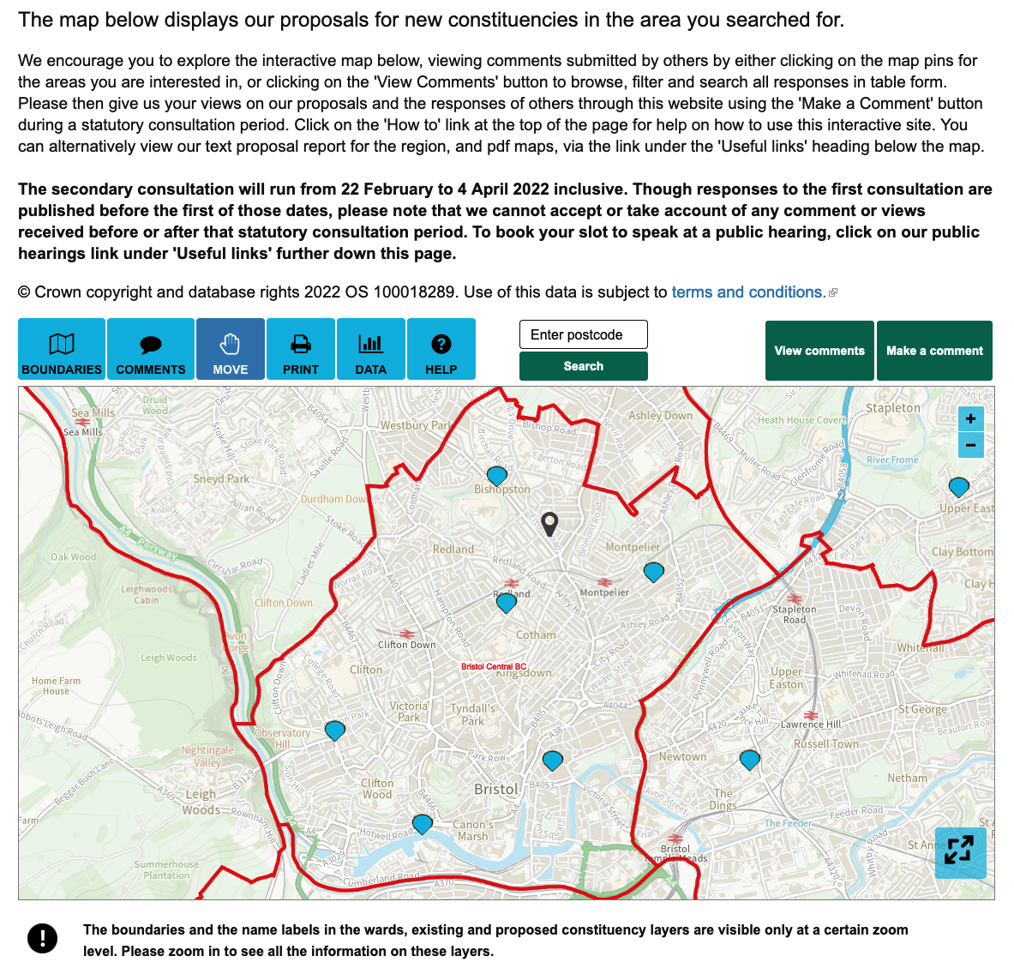
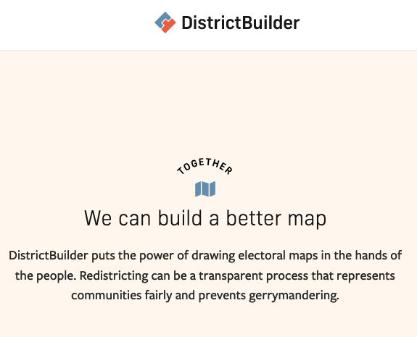
“Feedback”
“Feedforward”

Slide 47
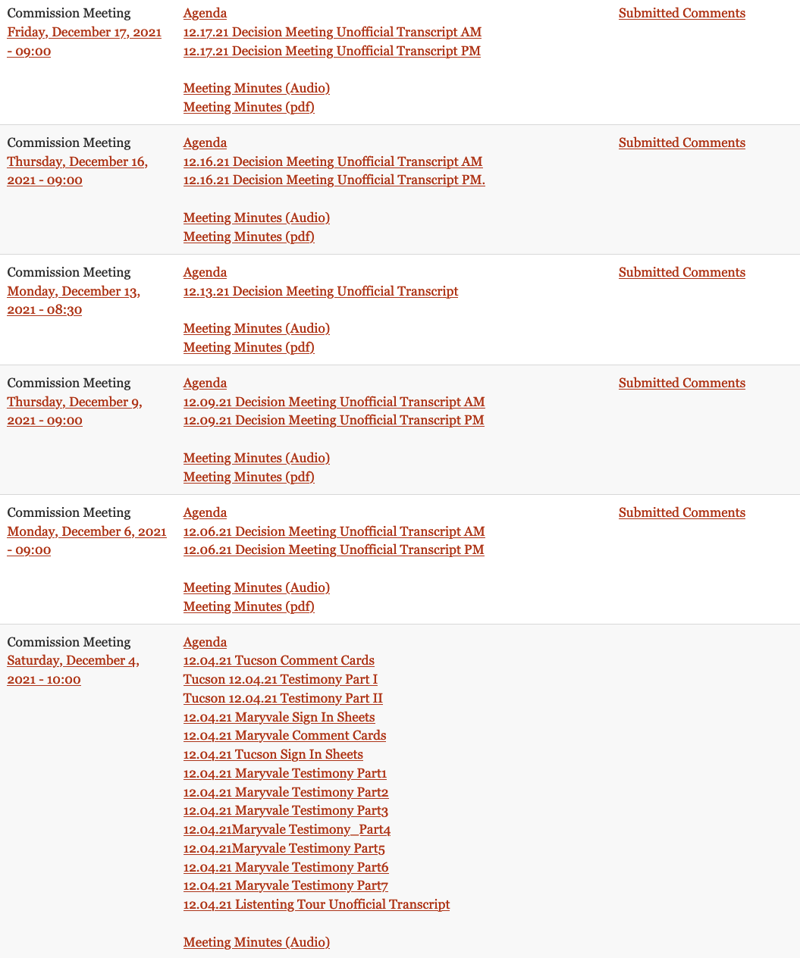
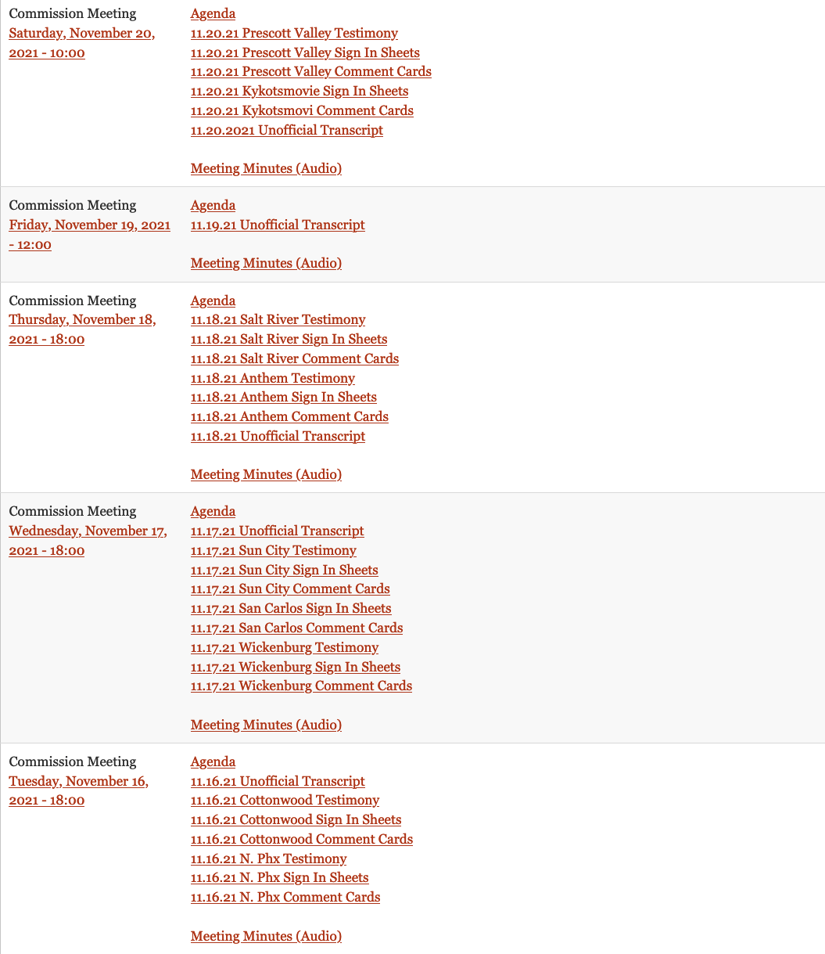
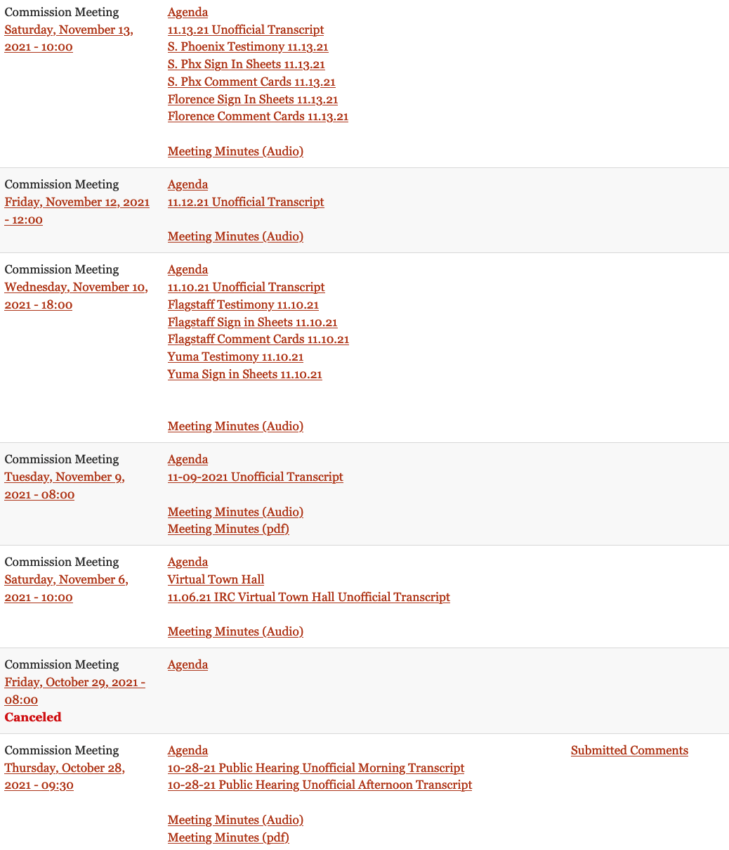
Many OTR participatory meetings where maps are drawn, discussed, and revised in public with, party,
Interest, and community groups in attendance.

Slide 48

(Multi-Member) Proportional Representation for historic/culturally significant regions
makevotesmatter.org.uk

Slide 49
Constituencies are something that we make, and could just as easily make differently

Slide 50
AGE
ACCESS
AND ABILITY
Analyzing the BCE 2023
Quantitative Spatial Sciences Lab
University of Bristol

